Slide 1
Autonomous Driving System Fault Prediction in Complex Scenarios Using CARLA
Daze lu
MAY 7

Slide 2
INTRODUCTION
Ensuring the safety of autonomous vehicles (AVs) relies on the early detection of faults in core subsystems such as perception, planning, and control—before they escalate into failures. However, real-world testing is constrained by high costs, safety risks, and the rarity of edge-case scenarios. To overcome these limitations, this work leverages the CARLA simulator to systematically recreate complex driving conditions, including challenging weather, dynamic traffic, and mechanical degradation, enabling scalable and risk-free evaluation of AV systems.
Contributions
Developed a simulation-based fault prediction framework using CARLA to emulate diverse and failure-prone scenarios.
Integrated the TransFuser model for end-to-end vehicle control with multi-modal sensor fusion (camera + LiDAR).
Collected structured simulation data under varied disturbances to support sequence-based fault prediction.
Objectives
Predict AV system failures using an LSTM model trained on simulated time-series data.
Identify environmental and behavioral factors that contribute to AV breakdowns.
Support pre-deployment safety validation by revealing hidden failure patterns in AV decision-making.

Slide 3
CURRENT CHALLENGES & MOTIVATIONS
Rare failures are hard to reproduce in real-world driving due to safety risks and unpredictable occurrence.
Public datasets lack coverage of the complex, high-risk scenarios (e.g., sudden pedestrian crossing, sensor degradation, or mechanical failure) that truly challenge AV systems.
Existing studies often isolate subsystems, focusing only on perception (e.g., sensor fault detection) or control (e.g., planning errors), which limits holistic understanding.
Limited integration of faults across perception, planning, and control leads to incomplete safety analysis.
Current research lacks:
Diverse and dynamic scenario generation under multi-agent traffic and weather variability.
Sequence-aware models capable of capturing temporal trends leading to failure.
Fusion of multi-modal sensor data (e.g., camera + LiDAR) in both decision-making and failure analysis.

Slide 4
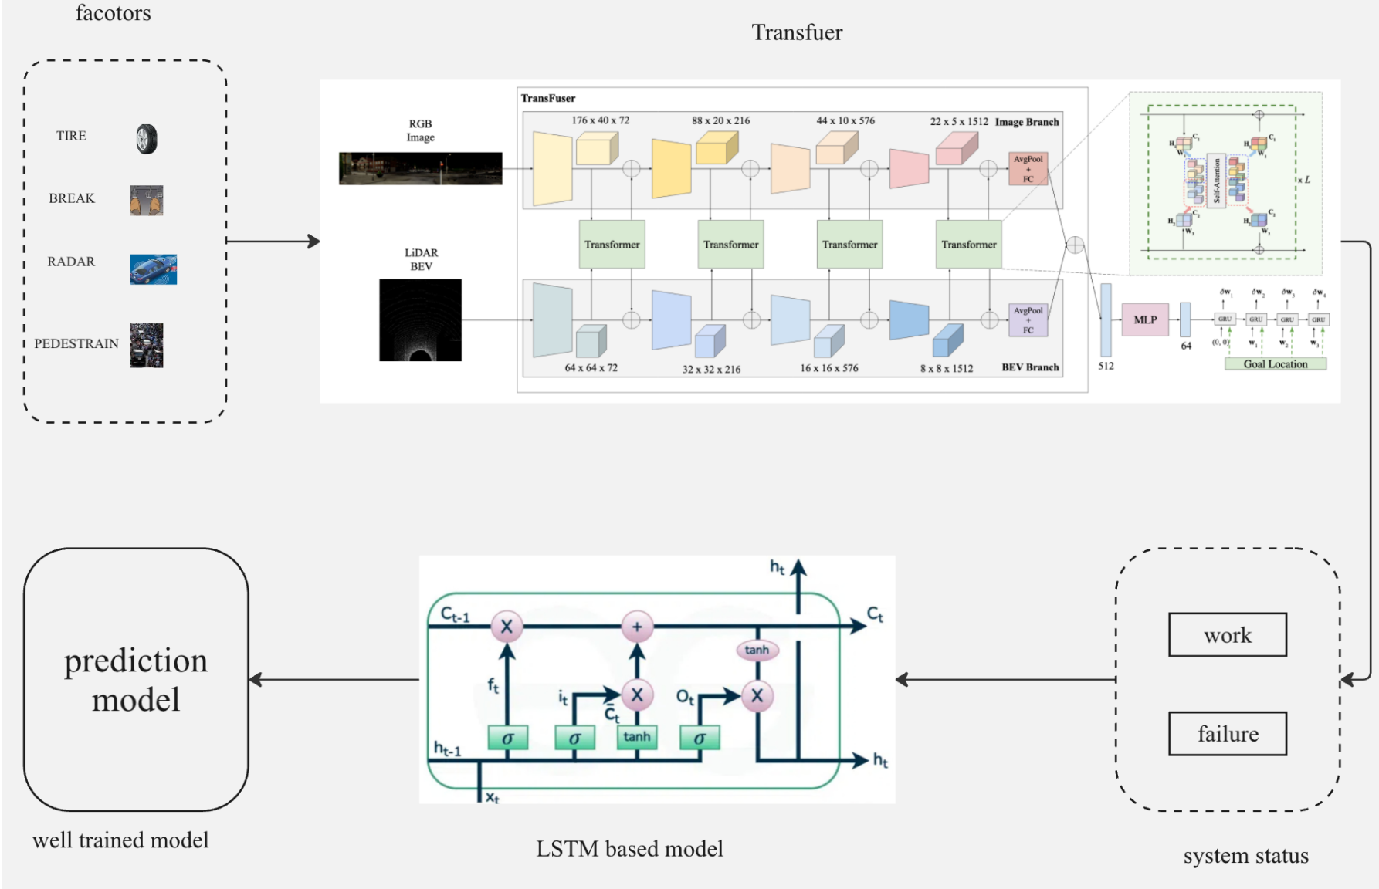
FRAMEWORKS

Slide 5
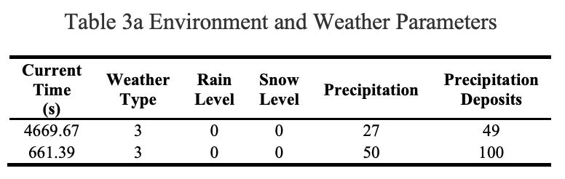
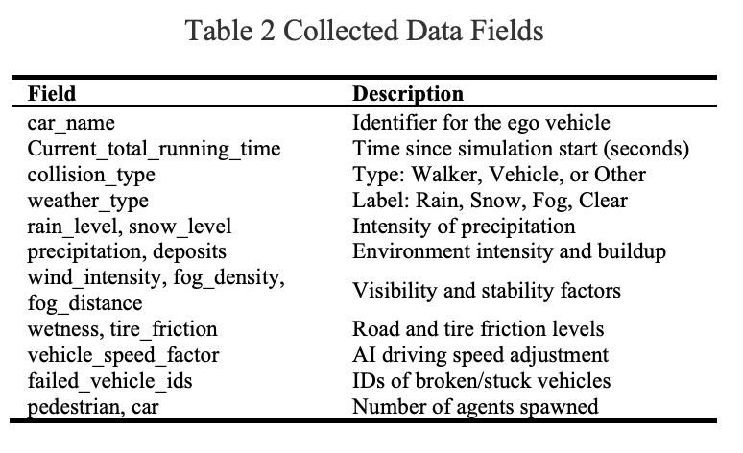
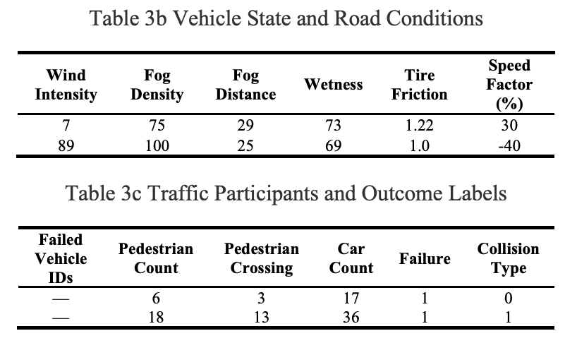
DATA COLLECTION

Slide 6
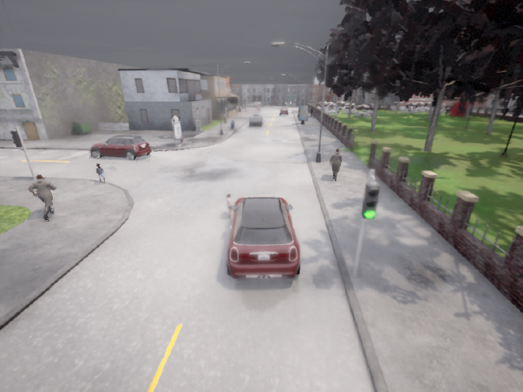
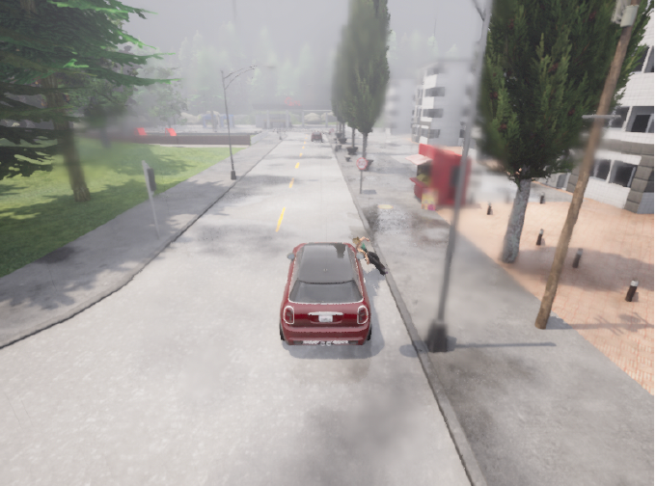
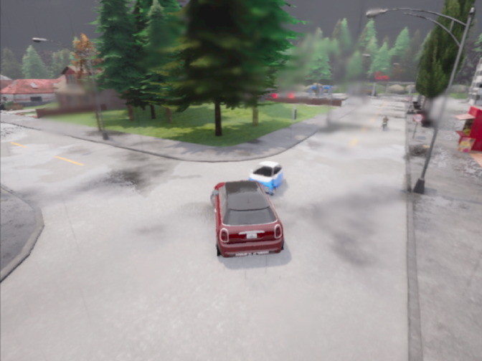
DATA COLLECTION-2
examples
Raining
Fog
clear

Slide 7
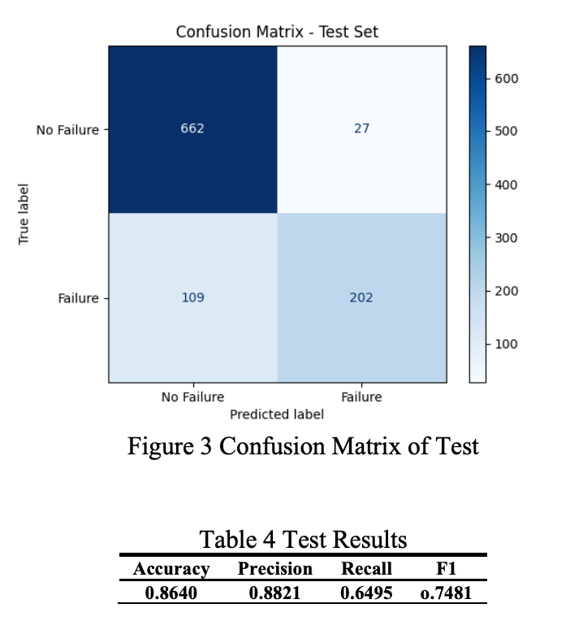
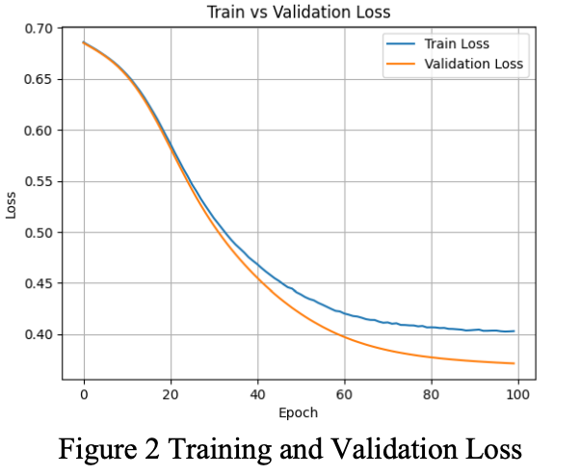
RESULTS

Slide 8
CONCLUSION
CARLA enables safe and scalable testing of AVs under rare and risky scenarios.
The LSTM model can effectively learn temporal patterns leading to failure.
High precision makes it suitable for early warning systems in AVs.
Future work:
Use more diverse maps
Introduce adversarial sensor failures
Apply to other public datasets and do comparation with others frameworks.

Slide 9
THANK YOU!

